Slide 1
PUBLIC HEALTH LAW
Past & Present

Slide 2
Disclaimer
The information provided in this discussion is for informational purposes only, and does not constitute legal advice. ChangeLab Solutions does not enter into attorney-client relationships.
ChangeLab Solutions is a non-partisan, nonprofit organization that educates and informs the public through objective, non-partisan analysis, study, and/or research. The primary purpose of this discussion is to address legal and/or policy options to improve public health. There is no intent to reflect a view on specific legislation.
© 2016 ChangeLab Solutions

Slide 3
CDC DISCLAIMER
These course materials are for instructional use only and are not intended as a substitute for professional legal or other advice. While every effort has been made to verify the accuracy of these materials, legal authorities and requirements may vary from jurisdiction to jurisdiction. Always seek the advice of an attorney or other qualified professional with any questions you may have regarding a legal matter.
The contents of this presentation have not been formally disseminated by the Centers for Disease Control and Prevention and should not be construed to represent any agency determination or policy.

Slide 4
Legal HISTORY reveals both the POWER & LIMITATIONS of government authority to protect the public’s health

Slide 5
Let’s go back in time

Slide 6
The Mayflower Compact

Slide 7
Mayflower Compact: Excerpt
“. . . covenant & combine ourselves together into a civil body politic; for our better ordering, and preservation and furtherance of the ends aforesaid; and by virtue hereof to enact, constitute, and frame, such just and equal laws, ordinances, acts, constitutions, and offices, from time to time, as shall be thought most meet and convenient for the general good of the colony; unto which we promise all due submission & obedience.”

Slide 8
The Broad Street Pump

Slide 9
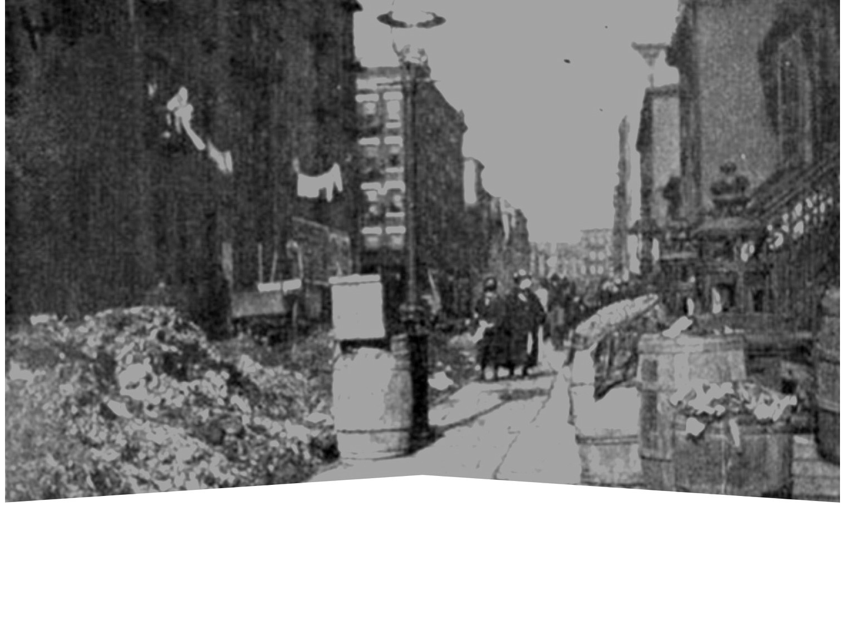
New York before sanitation reform

Slide 10
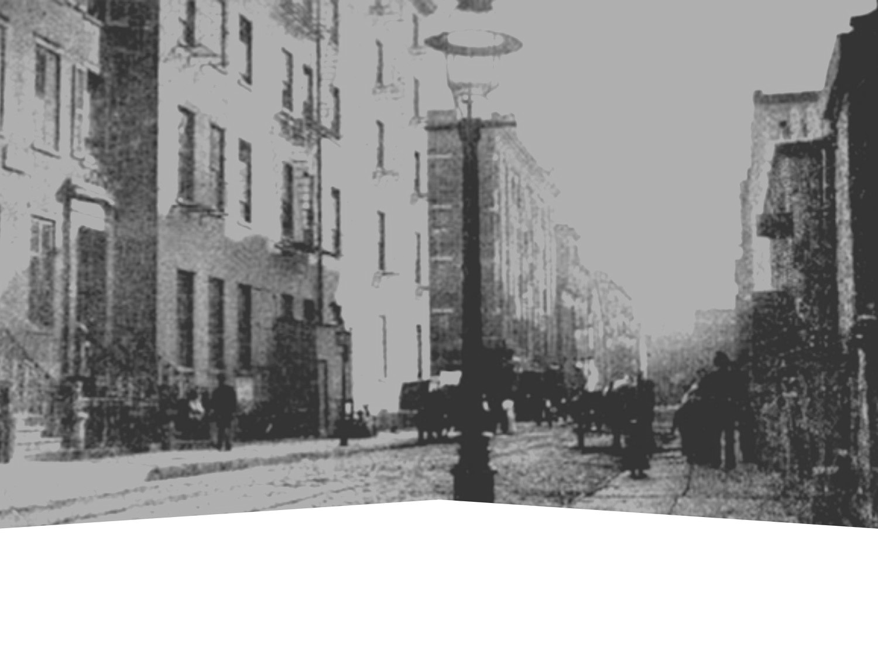
…and New York after the reform

Slide 11
The story of a 1902 smallpox outbreak in Massachusetts

Slide 12
“But the liberty secured by the Constitution of the United States to every person within its jurisdiction does not import an absolute right in each person to be, at all times and in all circumstances, wholly freed from restraint. There are manifold restraints to which every person is necessarily subject for the common good. On any other basis, organized society could not exist with safety to its members.”

Slide 13
This history forms the foundation for public health law today

Slide 14
Consider the history of tobacco control

Slide 15
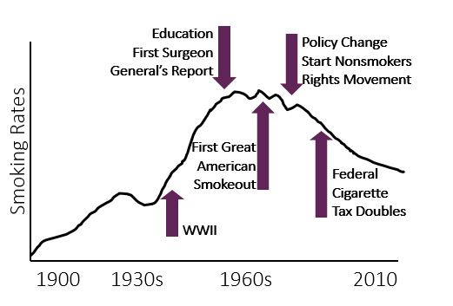
Public policy drove the decline of tobacco use

Slide 16
California 1989–2008
25% fewer tobacco-related diseases (compared to the rest of the nation)
6.79 billion fewer packs sold
$134 billion saved

Slide 17
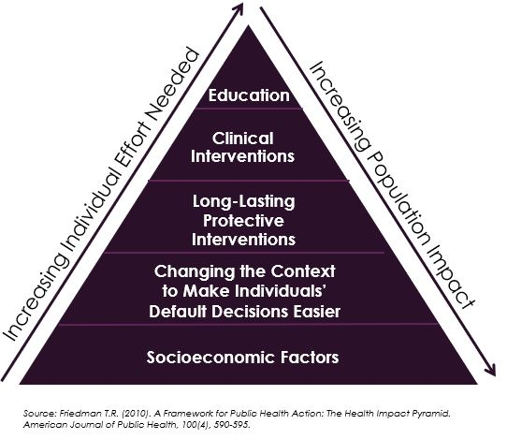
Health Impact Pyramid

Slide 18
This story applies to other public health challenges

Slide 19
Create transportation infrastructure

Slide 20
Maintain healthy housing

Slide 21
Prevent drug overdose deaths

Slide 22
Ensure food safety

Slide 23
Provide access to healthy foods

Slide 24
Prepare for emergencies

Slide 25
Who has the power to shape public policy to improve public health?

Slide 26
Look to the US Constitution

Slide 27
What are the public health powers of the federal government?

Slide 28
Federal regulations can incentivize local action

Slide 29
Federal government can also prohibit or preempt action

Slide 30
The states have the primary responsibility for public health

Slide 31
Police Power
Promotes the public health, safety, and general well-being of the community
Enacts and enforces laws for general welfare
Regulates private rights in the public interest

Slide 32
Some requirements
Must Be:
Must be reasonably designed to correct a condition adversely affecting the public good
Must be rationally related to public health, safety, or general welfare
Can’t Be:
Can’t violate state & federal laws or constitutions
Can’t be arbitrary or oppressive

Slide 33
California State Constitution: Excerpt
“A county or city may make & enforce within its limits all local, police, sanitary, and other ordinances and regulations not in conflict with general laws.”

Slide 34
What about tribal sovereignty?

Slide 35
State & Local Government Can…?
Investigate disease outbreaks
Create zoning for farmer’s markets
Require kids to wear helments
Limit portion sizes

Slide 36
What are the limitations on this power?

Slide 37
Individual Rights vs. The Common Good

Slide 38
The Bill of Rights

Slide 39
Constitutional Rights
Freedom of speech & religion
Right to bear arms
Search & seizure
Due process
Equal protection

Slide 40
According to the 5th & 14th amendments, the government cannot deprive people of life, liberty, or property without due process of law.

Slide 41
Procedural Due Process Did the government allow the right to fair and impartial legal proceedings before depriving someone of life, liberty, or property?

Slide 42
Substantive Due Process Does the government have an appropriate justification for depriving someone of life, liberty, or property?

Slide 43
Some things are more difficult for the government to regulate than others.

Slide 44
When fundamental liberties ARE NOT involved

Slide 45
The Rational Basis Test Is the government acting reasonably related to a legitimate government goal?

Slide 46
When fundamental liberties ARE involved

Slide 47
The Strict Scrutiny Test
Is the government action narrowly tailored, or is it the least restrictive alternative to achieve a compelling goal?

Slide 48
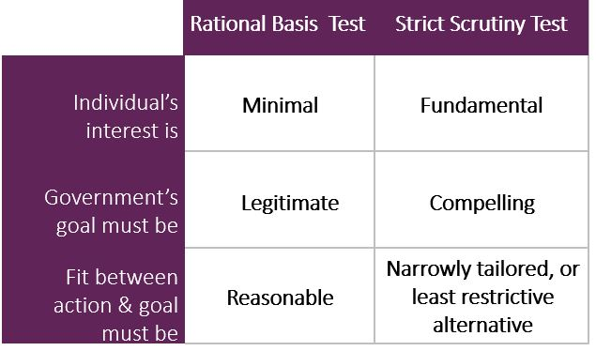
The government must tread carefully if a regulation affects fundamental liberties.

Slide 49
Mandatory Vaccinations: Example 1
Can the government require parents to vaccinate their children in order to attend public school?

Slide 50
Mandatory Vaccinations: Example 2
Can the government require parents to vaccinate their children in order to attend public school?
What about to attend private school?

Slide 51
Mandatory Vaccinations: Example 3
Can the government require parents to vaccinate their children in order to attend public school?
What about to attend private school?
What about for all children?

Slide 52
Equal Protection
According to the 5th & 14th amendments,
the government shall not “deny to any person within its jurisdiction the equal protection of the laws.”

Slide 53
Non-protected classifications

Slide 54
The Rational Basis Test
Is the government acting reasonably related to a legitimate government goal?

Slide 55
Can the government pass a law that imposes menu labeling requirements on large chain restaurants, but not on smaller chains or independents?

Slide 56
A law that applies to bigger, but not smaller, businesses needs only to be reasonably related to a legitimate government goal.

Slide 57
Protected Classes

Slide 58
The Strict Scrutiny Test: Revisited
Is the government action narrowly tailored to achieve a compelling goal?

Slide 59
More to consider
Can the government quarantine South Koreans suspected of being exposed to MERS?
What about limiting the number of fast food restaurants in certain parts of the city?
What about putting an age restriction on buying harmful products?

Slide 60
More to consider – Question 1
1. Can the government quarantine South Koreans suspected of being exposed to MERS?

Slide 61
More to consider – Question 2
2. What about limiting the number of fast food restaurants in certain parts of the city?

Slide 62
More to consider – Question 3
3. What about putting an age restriction on buying harmful products?

Slide 63
Legal HISTORY reveals both the POWER & LIMITATIONS of government authority to protect the public’s health.

Slide 64
Funding for this resource was made possible (in part) by the CDC. The views expressed in activity materials or publications and by speakers and moderators do not necessarily reflect the official policies of the Department of Health and Human Services, nor does the mention of trade names, commercial practices, or organizations imply endorsement by the US government.​ ​ Written materials for this activity were supported by the Cooperative Agreement Number NU38OT000307 from the CDC’s Office for State, Tribal, Local and Territorial Support.

Slide 65
Thank you! Any Questions?

Slide 66
Q. True or False? Preemption & Local Government
Local governments have legislative independence apart from states.

Slide 67
A. True or False? Preemption & Local Government
Local governments have legislative independence apart from states.
Answer: False

Slide 68
Q. True or False? Preemption & Federal Government
The federal government can control all aspects of state and local laws.

Slide 69
A. True or False? Preemption & Federal Government
The federal government can control all aspects of state and local laws.
Answer: False

Slide 70
Q. True or False? Due Process
A state can remove a child from his or her home to protect the child from a neglectful or abusive parent.

Slide 71
A. True or False? Due Process
A state can remove a child from his or her home to protect the child from a neglectful or abusive parent.
Answer: True

Slide 72
Q. True or False? Quarantine
To protect the public’s health, a state may quarantine a large number of individuals who have been exposed to a flu virus (e.g., avian flu or swine flu/H1N1).

Slide 73
A. True or False? Quarantine
To protect the public’s health, a state may quarantine a large number of individuals who have been exposed to a flu virus (e.g., avian flu or swine flu/H1N1).
Answer: False

Slide 74
Q. True or False? Fruits & Vegetables
A municipality can require parents or guardians to serve their children at least five fruits or vegetables each day.

Slide 75
A. True or False? Fruits & Vegetables
A municipality can require parents or guardians to serve their children at least five fruits or vegetables each day.
Answer: False

Slide 76
Q. True or False? Swimming Pools
A municipality can require all residents to install four-sided fences around their home swimming pools.

Slide 77
A. True or False? Swimming Pools
A municipality can require all residents to install four-sided fences around their home swimming pools.
Answer: True

Slide 78
Q. True or False? Mandatory Treatment
A state may require a child to receive mandatory treatment for communicable disease, even against the parents’ will.

Slide 79
A. True or False? Mandatory Treatment
A state may require a child to receive mandatory treatment for communicable disease, even against the parents’ will.
Answer: True

Slide 80
Q. True or False? Smokefree Homes
A state government can require parents or guardians to smoke outside their home if a child has asthma.

Slide 81
A. True or False? Smokefree Homes
A state government can require parents or guardians to smoke outside their home if a child has asthma.
Answer: True

Slide 82
Q. True or False? Equal Protection
Zoning codes can restrict fast food restaurants or tobacco sales in certain racial or ethnic communities because those communities have disproportionate rates of chronic diseases.

Slide 83
A. True or False? Equal Protection
Zoning codes can restrict fast food restaurants or tobacco sales in certain racial or ethnic communities because those communities have disproportionate rates of chronic diseases.
Answer: False

Slide 84
Q. True or False? Motorcycle Helmets
A state can require motorcyclists to wear helmets, but can exempt bicyclists from this requirement.

Slide 85
A. True or False? Motor Cycle Helmets
A state can require motorcyclists to wear helmets, but can exempt bicyclists from this requirement.
Answer: True

Slide 86
Q. True or False? MERS
The government may quarantine South Koreans suspected of being exposed to Middle East Respiratory Syndrome (MERS) virus if they come to the United States.

Slide 87
A. True or False? MERS
The government may quarantine South Koreans suspected of being exposed to Middle East Respiratory Syndrome (MERS) virus if they come to the United States.
Answer: False

Slide 88
Q. True or False? Tobacco in Pharmacies
A municipality can prohibit the sale of tobacco products at stores that also sell prescription pharmaceuticals.

Slide 89
A. True or False? Tobacco in Pharmacies
A municipality can prohibit the sale of tobacco products at stores that also sell prescription pharmaceuticals.
Answer: True

Slide 90
Q. True or False? Alcohol Sales
A municipality can prohibit the sale of tobacco products at stores that also sell prescription pharmaceuticals.

Slide 91
A. True or False? Alcohol Sales
A state can prohibit the sale of alcohol in gas station mini-marts and grocery stores, but can allow such sales in corner stores without gas stations.
Answer: True

Slide 92
Q. True or False? Toy Giveaways
A state can require fast food restaurants with more than 10 locations in the state to have healthy meal offerings if they give away toys as an incentive item, but restaurants with fewer locations could be exempt from this requirement.

Slide 93
A. True or False? Toy Giveaways
A state can require fast food restaurants with more than 10 locations in the state to have healthy meal offerings if they give away toys as an incentive item, but restaurants with fewer locations could be exempt from this requirement.
Answer: True

